Slide 1
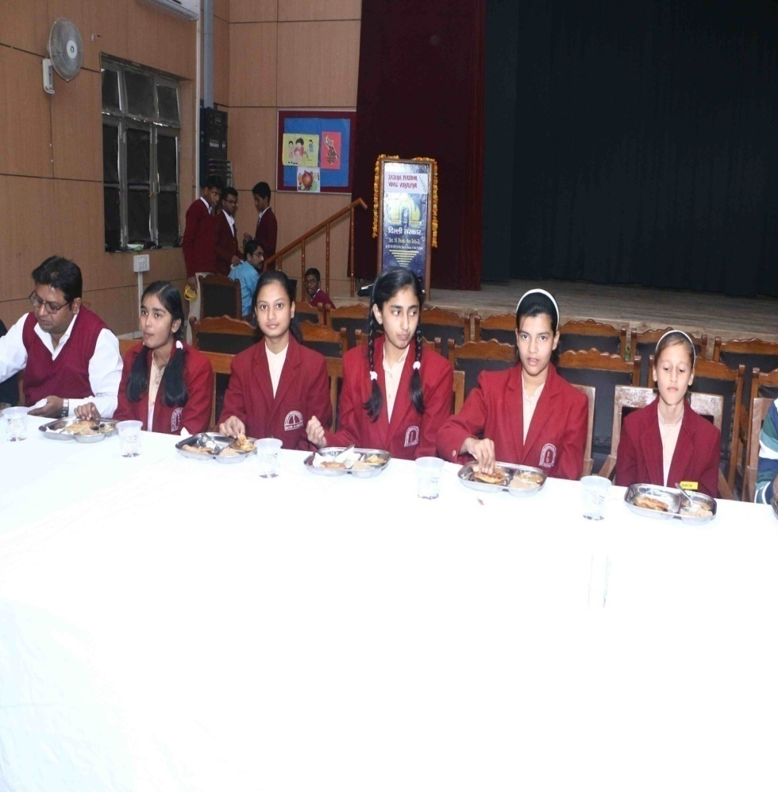
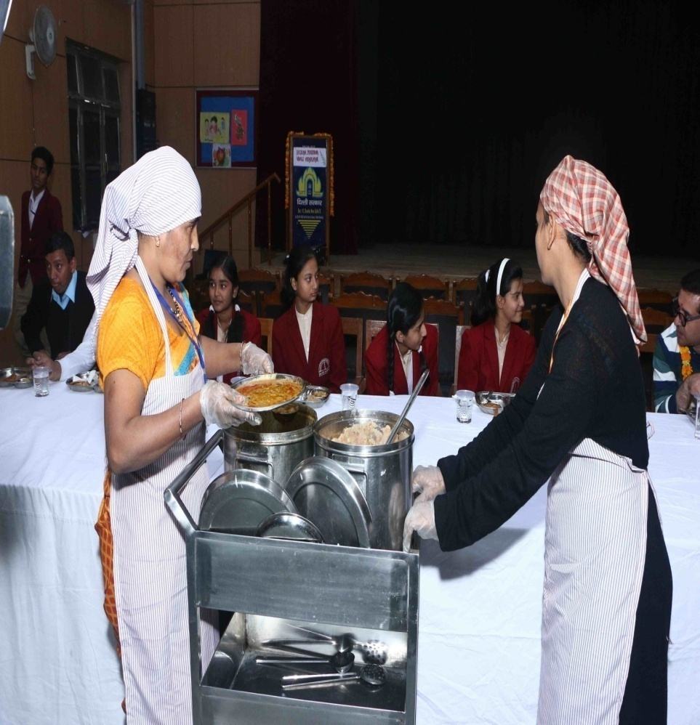
Students enjoying Mid Day Meal in a school of DOE

Slide 2
ANNUAL WORK PLAN & BUDGET 2018-19
MDM- PAB Meeting- DELHI

Slide 3
STRUCTURE OF THE PRESENTATION:
Introduction/Background
Enrolment
Financial Norms (MHRD)
Menu
Monitoring
Testing by FICCI
DOE Inspections
New Initiatives
Achievements
Expenditure Review 2017-18
Budget Provision for 2018-19

Slide 4
INTRODUCTION / BACKGROUND :
Mid Day Meal Scheme is centrally sponsored Scheme of Ministry of HRD, Govt. of India.
Under this scheme, cooked Mid Day Meal is provided to the children of primary and upper primary classes of Govt. & Govt. Aided Schools of GNCT of Delhi through 54 Service Providers having semi automated kitchens for preparation of meal.
In Delhi, MDM Scheme is implemented through Six implementing agencies i.e. DOE, 3MCDs, NDMC and DCB.
Dte. of Education is the Nodal Office for implementation of MDM Scheme in Delhi.

Slide 5
Enrolment ___________________________________________________________________________________
Name of Department | No. of Schools | No of students (I- V) | No of students ( VI – VIII)
DOE & Aided Schools/AIE Centers | 1202 | 149615 | 666309
South MCD | 605 | 267721 | 0
North MCD | 738 | 328453 | 0
East MCD | 377 | 176816 | 0
NDMC | 45 | 13273 | 7108
DCB | 6 | 2100 | 900
Total | 2973 | 937978 | 674317
Total Coverage | 16.12 Lakhs

Slide 6
Financial Norms (MHRD)
Food grains from FCI (wheat/rice) @ 100 gms & 150 gms per child per day for Primary and Upper Primary
The transportation cost of the food grains from FCI Depot to the kitchen @ Rs. 75/- per quintal
Honorarium of Rs. 1000/- per month paid to the Cook-cum-Helpers
Cooking Cost for Primary per Student Rs.4.13/-
Cooking Cost for Upper Primary per Student Rs.6.18/-

Slide 7
Menu of MDM
Wheat based items: -
1. Atta & Besan Poori with Aaloo Curry/or Mixed Vegetables.
2. Atta Poori with Chholley(mashed vegetables added to the gravy)
3. Paushtik Daliya
Rice based items:-
1. Rice Chholley with mashed vegetables added to the gravy
2. Rice with Sambar/Dal (with vegetables added to the gravy)
3. Rice with Kadhi(with vegetables added to the gravy)

Slide 8
Monitoring:
School Level MDM Committee constituted comprising of:
HOS, Teacher In-charge MDM, Home Science Teacher, three mothers of students, DDO & one VKS Member.
Recent Instruction
School Management Committee (SMC) also monitor the implementation of the Mid Day Meal Scheme and to ensure that it meets the hygienic standards as specified by the department.
Directorate of Education vide circular dated 25/04/2014 has constituted a Grievances Redressal Committee in each District of Education under Sec-32 of the right of children to free and compulsory Act (RTEA) 2009

Slide 9
Monitoring:
There is intense monitoring system at School, Zone, District and Head Quarter Levels in Delhi to ensure supply of healthy, hygienic, hot & fresh meal to children.
To check any contamination in meal, food is tasted by the members of the committee before distribution of food among the students.
Zonal Level Steering Cum Monitoring Committee :
EO, Two Principals, Two Parents and one VKS Member to check the kitchens of the Service Providers and food supplied in schools.
in case of supplying substandard/contaminated meal to the children, a very prompt action is taken by the Dte. of Education against the Service Providers such as imposing of penalty/compensation to the children/cancellation of agreement, etc.

Slide 10
Action Taken:
Directorate of Education has engaged the FICCI Research and Analysis Centre for testing the samples of cooked Mid Day Meal and raw food grains w.e.f. February. 2016.
4 samples per month (three from schools and one from kitchen) of each service provider are lifted and tested by FICCI Research and Analysis Center.
One sample of food grain (at the time of lifting from FCI) is also lifted for the testing it’s quality.
In 2017-18, total 1124 samples were lifted for testing which were found fit for human consumption.
In 2017-18, total 225 inspections of the kitchens were carried out by Deputy Director of Education (Zones).

Slide 11
New initiatives:
Milk is being distributed to the students of 06 schools of Directorate of Education by M/s Mother Dairy on pilot basis.

Slide 12
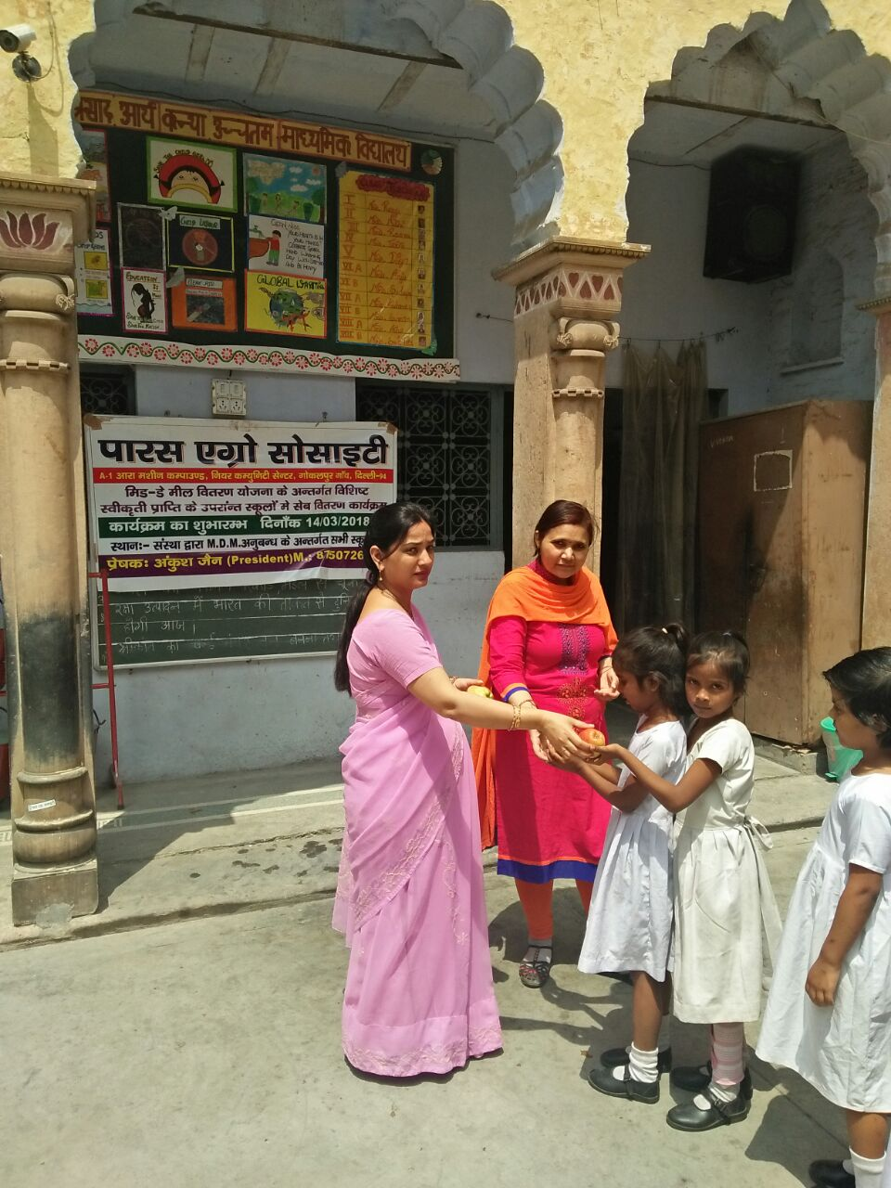
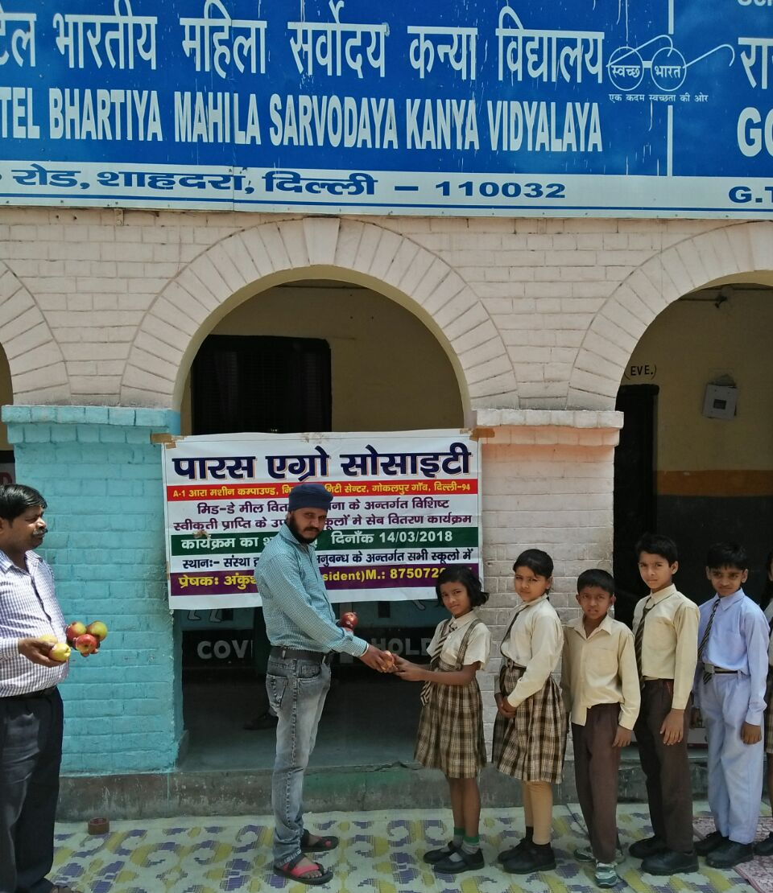
New initiatives: (2)
Apple is distributed once in a fortnightly by M/s Paras Agro Society (Service Provider of MDM) among the student allocated to it from it’s own resources.

Slide 13
New initiatives: (03)
In January 2018, training has been imparted to 60 Cook-cum-Helpers as a master trainer by FSSAI.

Slide 14
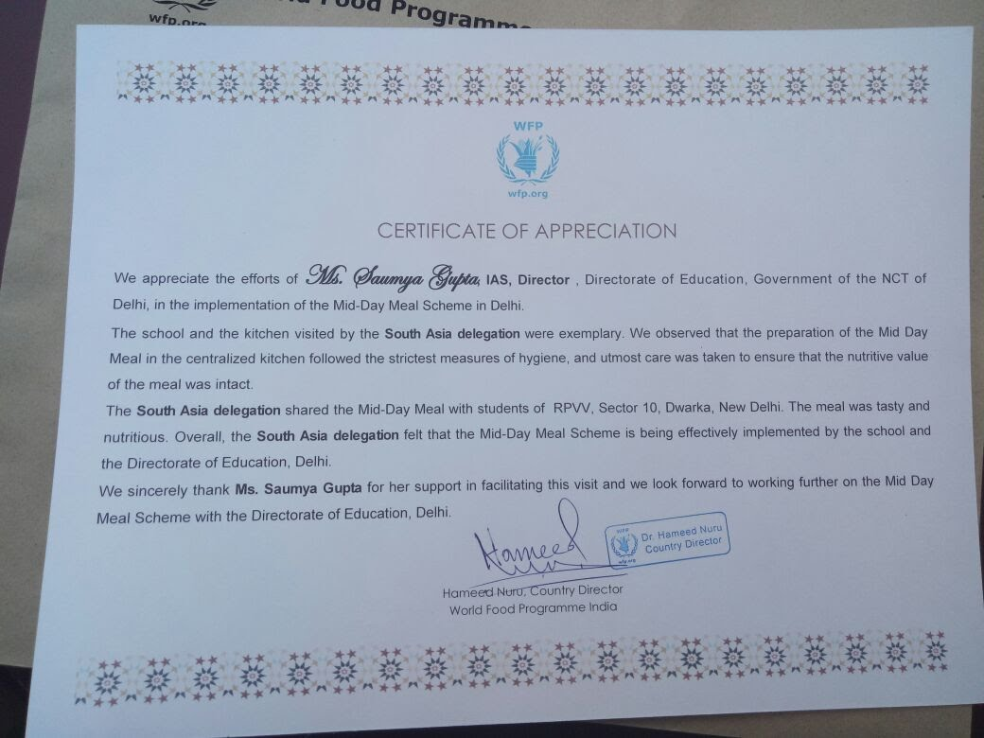
Achievement:
In a event organized by UN Word Food Programme, a delegation of SAARC countries visited MDM kitchens & schools on 27-29th Nov., 2017 and appreciated the implementation of Mid Day Meal Scheme in Delhi.

Slide 15
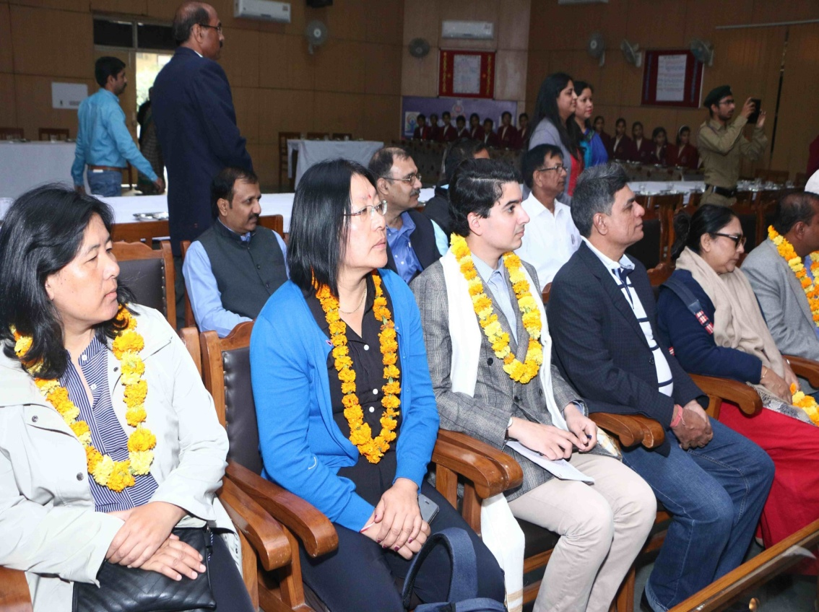
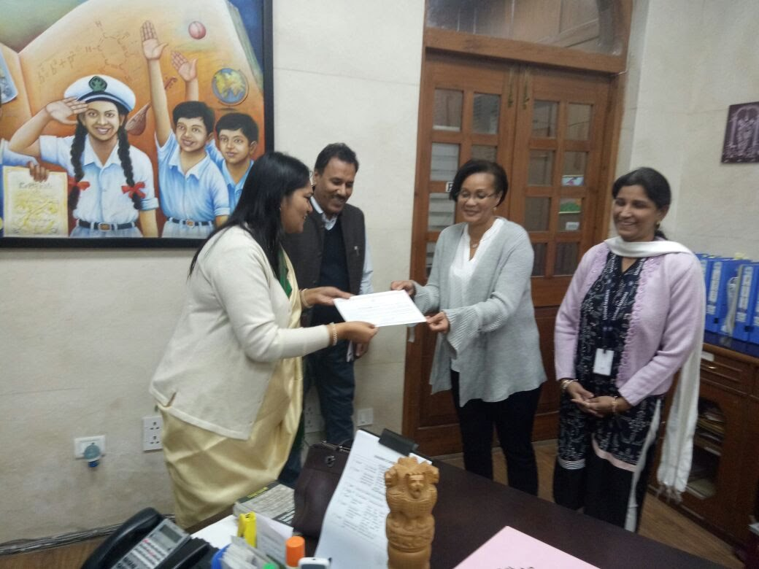
Achievement:

Slide 16
New Proposals to supplement Mid Day Meal:
Keeping the objective of improving upon the nutritional indices of growing children in mind, following proposals are under process in Directorate of Education :-
Providing of Mid Day Meal to the girls students of class 9th to 12th.
Providing of banana twice/thrice a week as a supplement with MDM.

Slide 17
Expenditure Review 2017-18 (Primary and Upper Primary) (Component wise included unspent of 2016-17)
Rs. In Lakhs)
S. No. | Component | Release Central Share | Release State Share | Expenditure Central Share | Expenditure State Share | Total Release | Total Expenditure
1 | Cost of Food grains | 654.62 | 0 | 654.62 | 0 | 654.62 | 100%
2 | Cooking Cost | 4505.41 | 5531.52 | 4418.65 | 5399.02 | 10036.93 | 97.82%
3 | Honorarium to Cook-cum-Helper | 696.10 | 1468.48 | 696.10 | 1468.48 | 2164.58 | 100%
4 | Transportation Assistance | 196.84 | 0 | 196.84 | 0 | 196.84 | 100%
5 | MME | 155.11 | 0 | 93.35 | 0 | 155.11 | 60.18%
6 | Kitchen Devices | 0 | 0 | 0 | 0 | 0 | 0
Total |  | 6208.08 | 7000.00 | 6059.56 | 6867.50 | 13208.08

Slide 18
Budget Provision for 2018-19 (Primary & Upper Primary) __________________________________________________________________________________
(Rs. In Lakhs)
S. No. | Component | Provision 2018-19
 |  | Central share 60% | State Share 40%
1 | Cost of Food grains | 1048.75 | ……
2 | Cooking Cost | 8926.14 | 5950.77
3 | Honorarium to Cook-cum-Helper | 1142.16 | 761.44
4 | Transportation Assistance | 314.62 | ……
5 | MME | 205.76 | …….
 | Total | 11637.43 | 6712.21

Slide 19
THANKS

